Slide 1
Matplotlib Overview
Module 02
Data Science Developer

Slide 2
Introduction
Matplotlib is the "grandfather" library of data visualization with Python. It was created by John Hunter.
He created it to try to replicate MatLab's (another programming language) plotting capabilities in Python.
So if you happen to be familiar with matlab, matplotlib will feel natural to you.
It is an excellent 2D and 3D graphics library for generating scientific figures.

Slide 3
Some of the major Pros of Matplotlib
Generally easy to get started for simple plots
Support for custom labels and texts
Great control of every element in a figure
High-quality output in many formats
Very customizable in general

Slide 4
Installation
You'll need to install matplotlib first with either:
conda install matplotlib
or pip install matplotlib

Slide 5


Importing
You'll also need to use this line to see plots in the notebook:
That line is only for jupyter notebooks, if you are using another editor, you'll use: plt.show() at the end of all your plotting commands to have the figure pop up in another window.

Slide 6
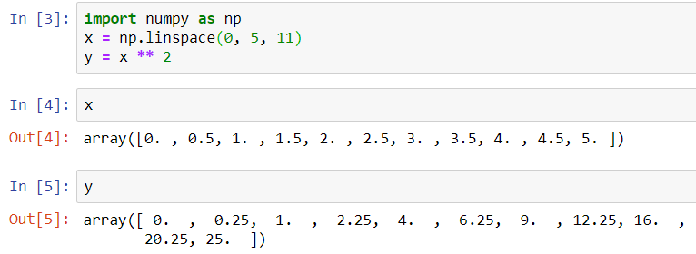
Example using 2 numpy arrays

Slide 7
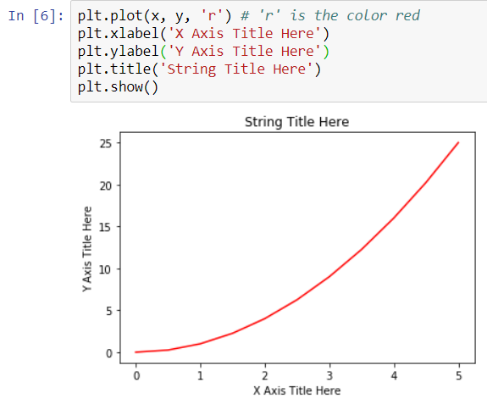
Basic Matplotlib Commands

Slide 8
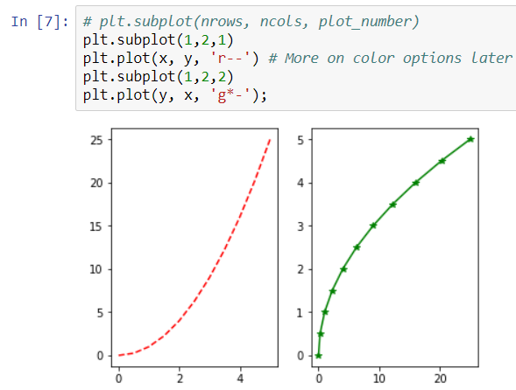
Creating Multiplots on Same Canvas

Slide 9
Matplotlib Object Oriented Method
Now that we've seen the basics, let's break it all down with a more formal introduction of Matplotlib's Object Oriented API.
This means we will instantiate figure objects and then call methods or attributes from that object.

Slide 10
Introduction to the OOM
The main idea in using the more formal Object Oriented method is to create figure objects and then just call methods or attributes off of that object.
This approach is nicer when dealing with a canvas that has multiple plots on it.

Slide 11
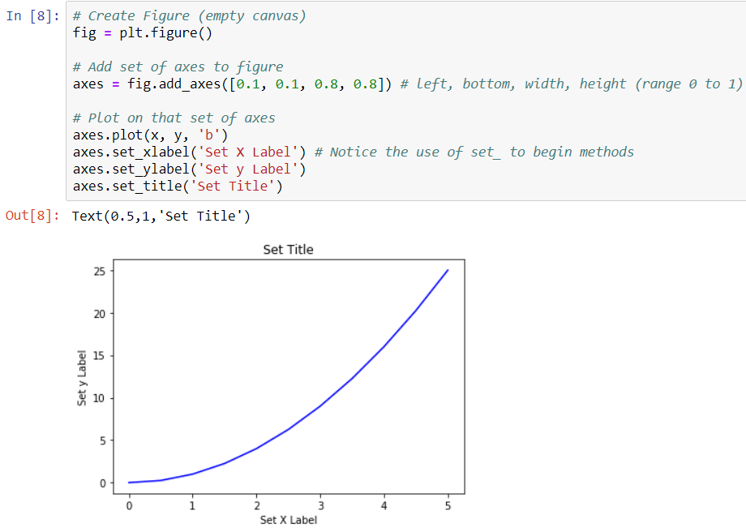
Introduction to the OOM
To begin we create a figure instance. Then we can add axes to that figure:

Slide 12
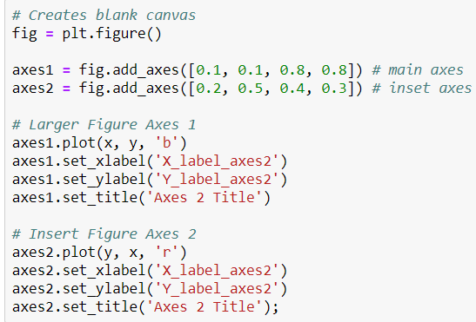
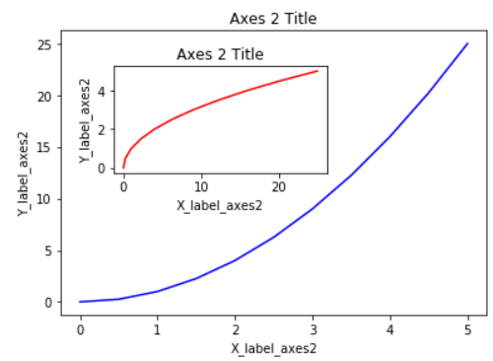
Introduction to the OOM
Code is a little more complicated, but the advantage is that we now have full control of where the plot axes are placed, and we can easily add more than one axis to the figure:

Slide 13
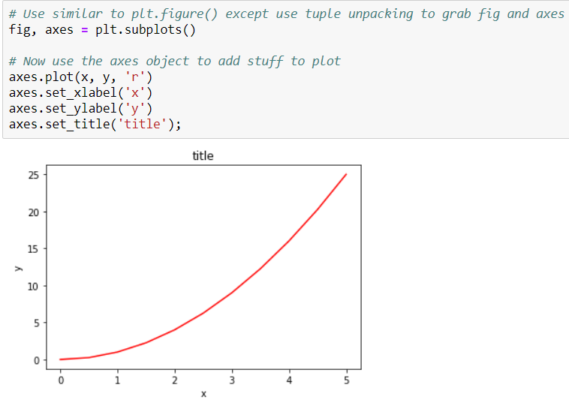
subplots()
The plt.subplots() object will act as a more automatic axis manager.
Basic use cases:

Slide 14
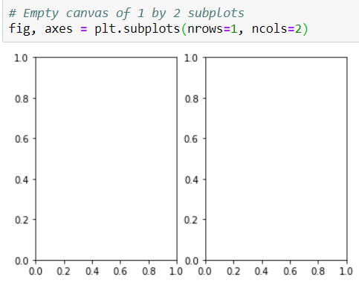
subplots()
Then you can specify the number of rows and columns when creating the subplots() object:

Slide 15
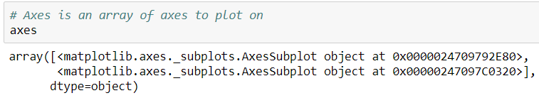
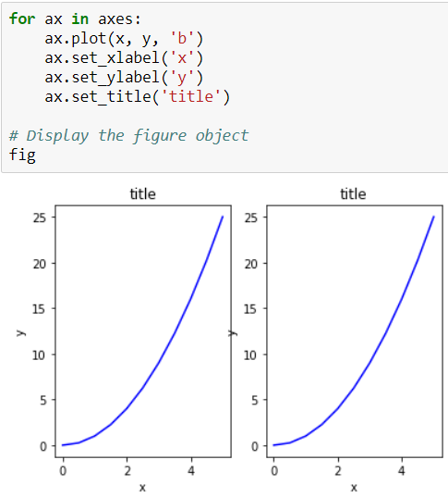
We can iterate through this array:

Slide 16
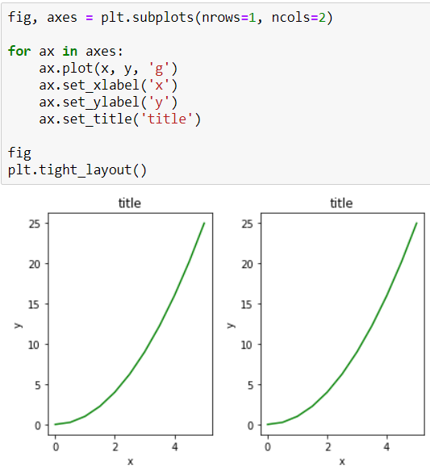
A common issue with matplolib is overlapping subplots or figures.
We can use fig.tight_layout() or plt.tight_layout() method, which automatically adjusts the positions of the axes on the figure canvas so that there is no overlapping content:

Slide 17

Figure size, aspect ratio and DPI
Matplotlib allows the aspect ratio, DPI and figure size to be specified when the Figure object is created. You can use the figsize and dpi keyword arguments.
figsize is a tuple of the width and height of the figure in inches
dpi is the dots-per-inch (pixel per inch).
For example:

Slide 18
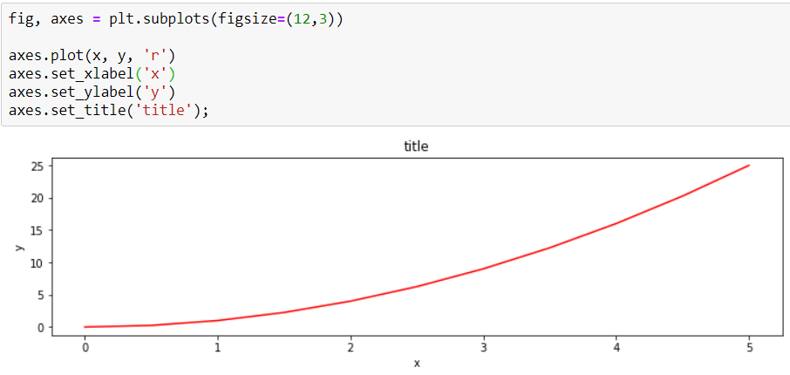
The same arguments can also be passed to layout managers, such as the subplots function:

Slide 19


Saving Figures
Matplotlib can generate high-quality output in a number formats, including PNG, JPG, EPS, SVG, PGF and PDF.
To save a figure to a file we can use the savefig method in the Figure class:
Here we can also optionally specify the DPI and choose between different output formats:

Slide 20


Legends, labels and titles
Now that we have covered the basics of how to create a figure canvas and add axes instances to the canvas, let's look at how decorate a figure with titles, axis labels, and legends.
Figure titles
A title can be added to each axis instance in a figure. To set the title, use the set_title method in the axes instance:
Axis labels
Similarly, with the methods set_xlabel and set_ylabel, we can set the labels of the X and Y axes:

Slide 21
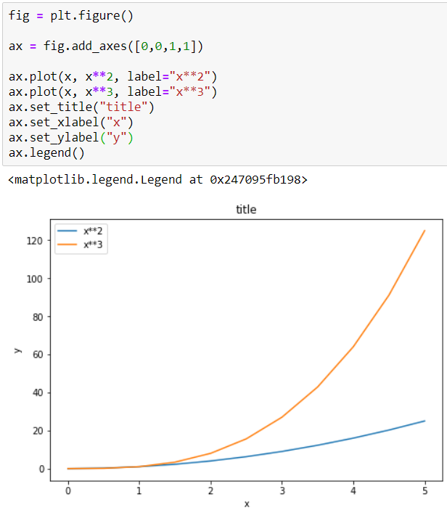
Legends
You can use the label="label text" keyword argument when plots or other objects are added to the figure, and then using the legend method without arguments to add the legend to the figure:

Slide 22
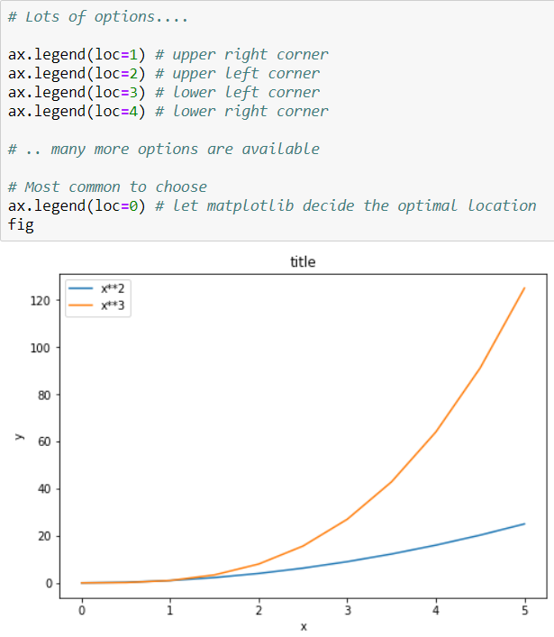
The legend function takes an optional keyword argument loc that can be used to specify where in the figure the legend is to be drawn. The allowed values of loc are numerical codes for the various places the legend can be drawn. Some of the most common loc values are:

Slide 23
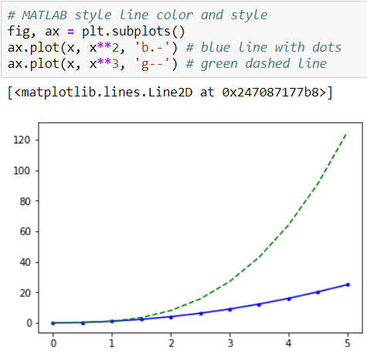
Setting colors, linewidths, linetypes Colors with MatLab like syntax
With matplotlib, we can define the colors of lines and other graphical elements in a number of ways. First of all, we can use the MATLAB-like syntax where 'b' means blue, 'g' means green, etc. The MATLAB API for selecting line styles are also supported: where, for example, 'b.-' means a blue line with dots:

Slide 24
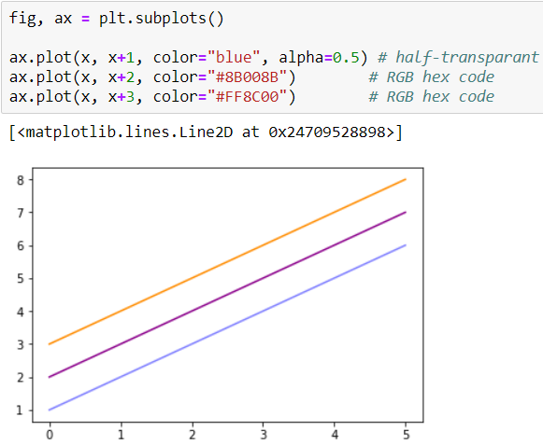
Colors with the color= parameter
We can also define colors by their names or RGB hex codes and optionally provide an alpha value using the color and alpha keyword arguments. Alpha indicates opacity.

Slide 25
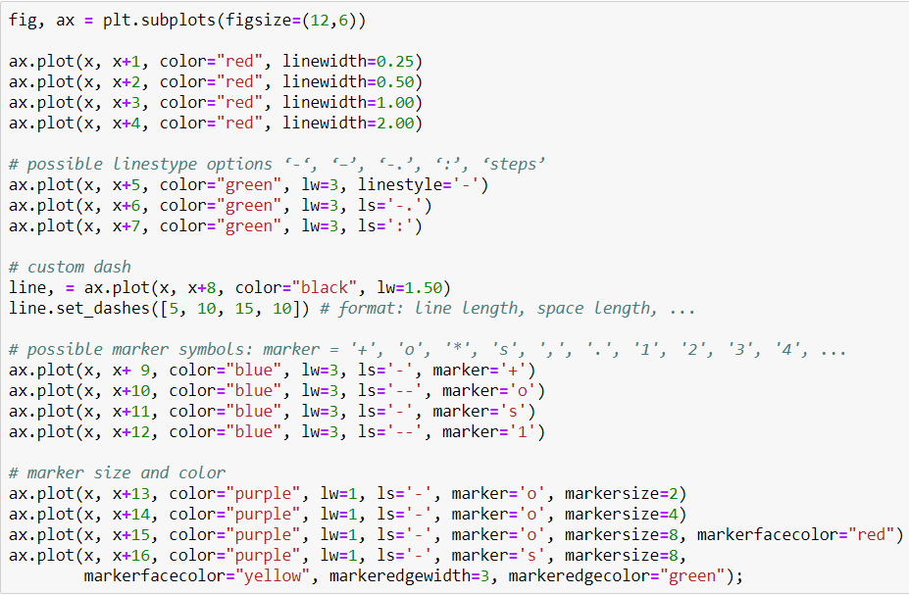
Line and marker styles
To change the line width, we can use the linewidth or lw keyword argument. The line style can be selected using the linestyle or ls keyword arguments:

Slide 26
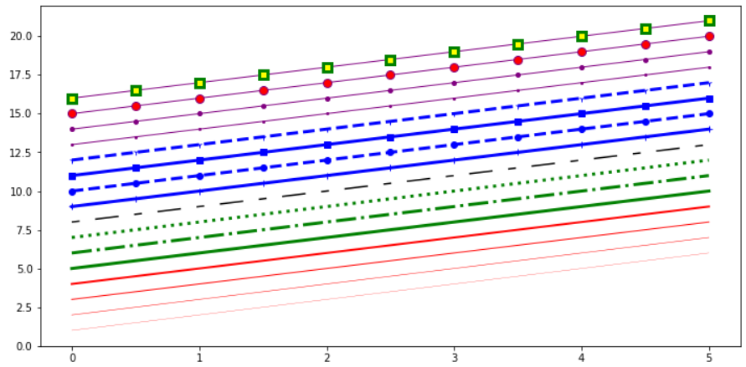

Slide 27
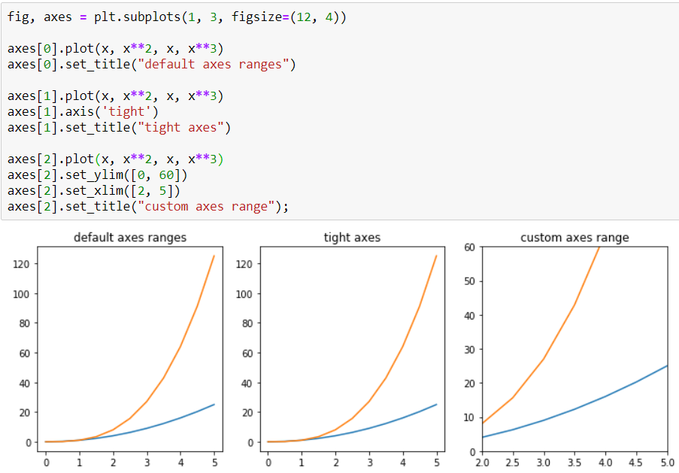
Plot Range
We can configure the ranges of the axes using the set_ylim and set_xlim methods in the axis object, or axis('tight') for automatically getting "tightly fitted" axes ranges:

Slide 28
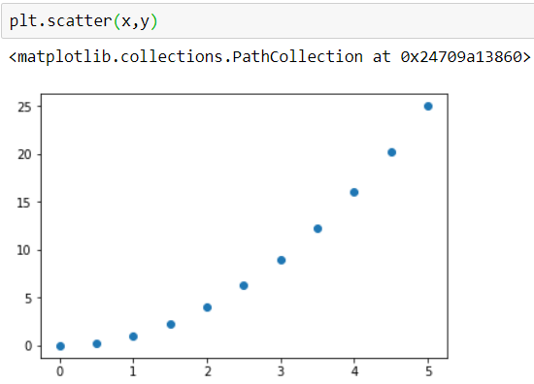
Special Plot Types
There are many specialized plots we can create, such as barplots, histograms, scatter plots, and much more. Most of these type of plots we will actually create using seaborn, a statistical plotting library for Python. But here are a few examples of these type of plots:

Slide 29
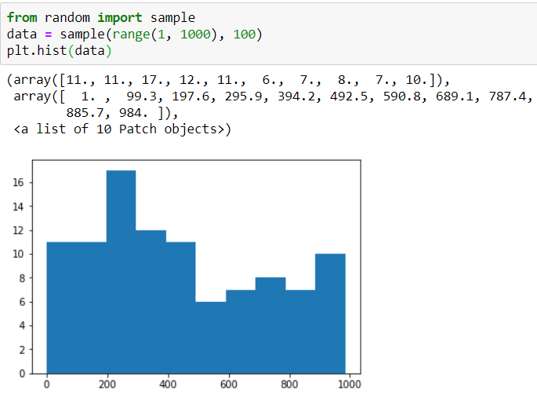

Slide 30
